Slide 1
DU Shuttle Service
Shuttle Your Way Across Campus!

Slide 2
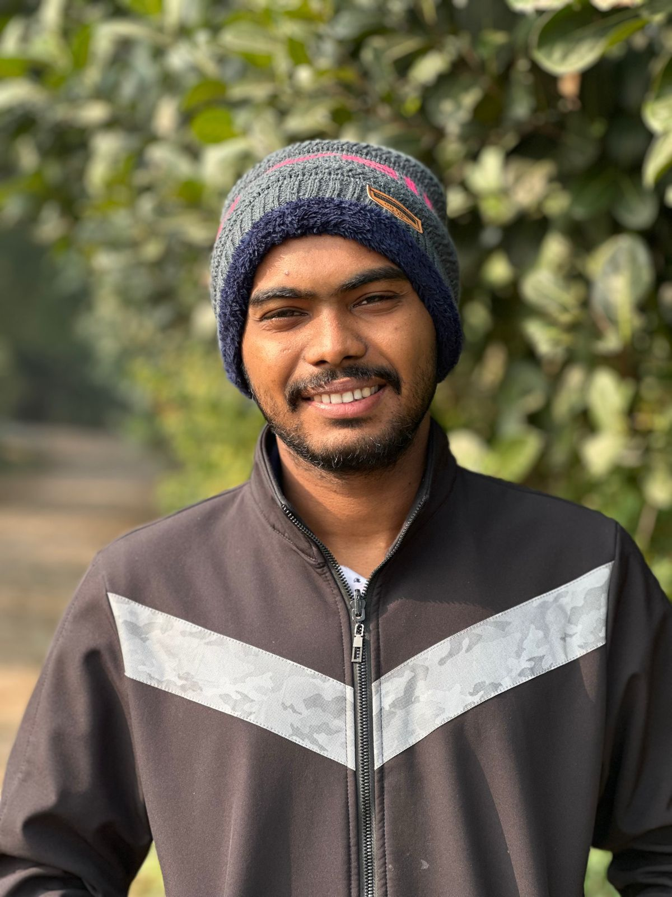
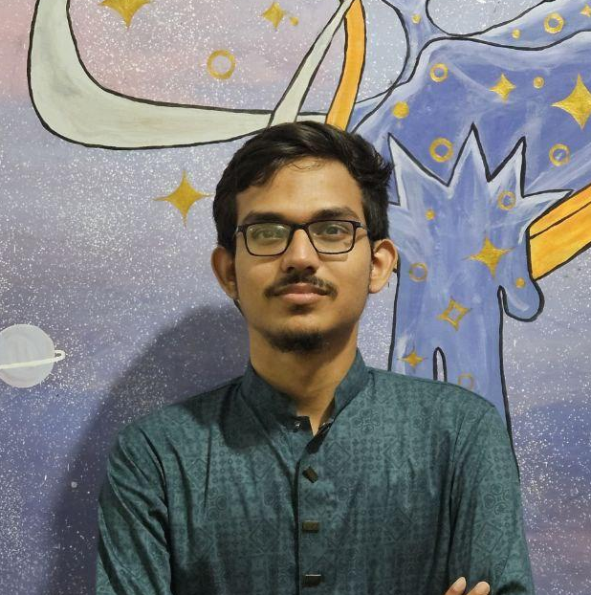
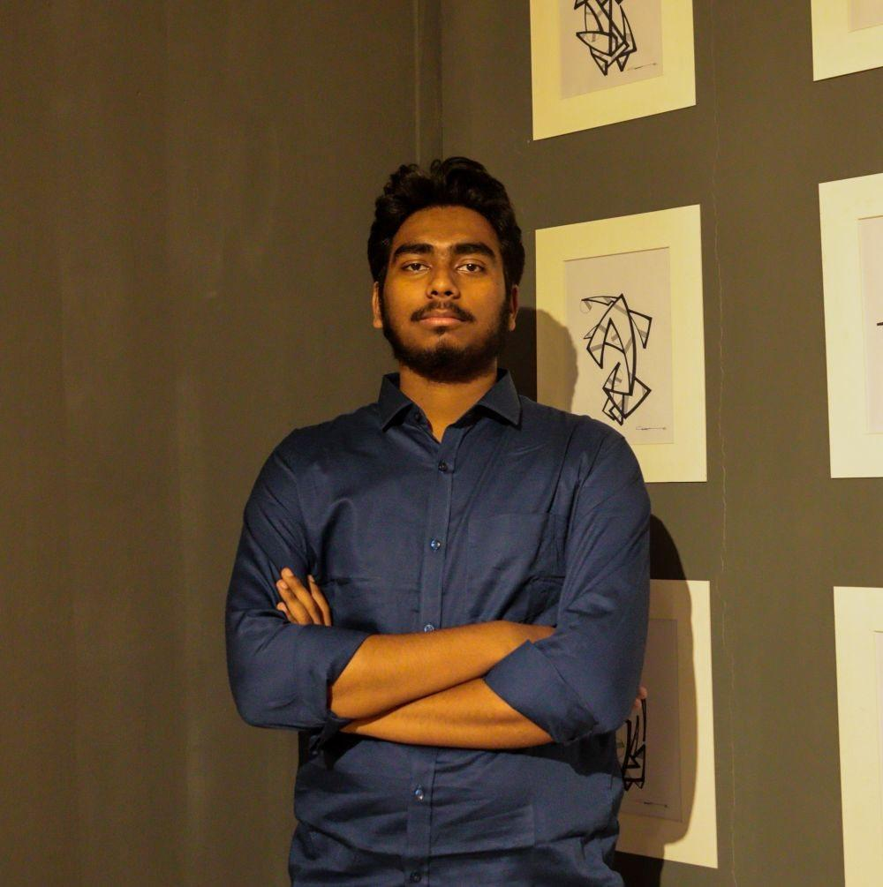
Team Members
Aditto Raihan
Roll: 09
Jotish Biswas
Roll: 31
Abul Hasan Anik
Roll: 53

Slide 3
Purpose of the Project
Easily Accessible Application
Enhancing Campus Transportation
Smart Ticketing & Routes Details
A Seamless & Cashless Shuttle Experience for DU students
Easy Booking, Smooth Travel

Slide 4
Project overview
Account Creation & User Authentication
Buy Tickets
Add Money & Balance Checking
Route Details
Quickbot Service
Emergency Call & Complain/Suggestion

Slide 5
Technical Usage
Programming Language (JAVA) & IDE- Netbean
OOP Principles(Polymorphism,Abstraction,Inheritance & Encapsulation)
OOP Mechanism(Exception Handling & Threading)
Graphical User Interface (JAVA-Swing)
Database (MySQL)

Slide 6
Work DIstribution
Aditto Raihan
Signup
Forgot Password
Balance
Emergency Call
Designing
Jotish Biswas
Start Page
Guest Page
QuickBot
Route Detail
UML Diagram
Abul Hasan Anik
Login
Profile
Payment
Add Money
Complain/Suggestion

Slide 7
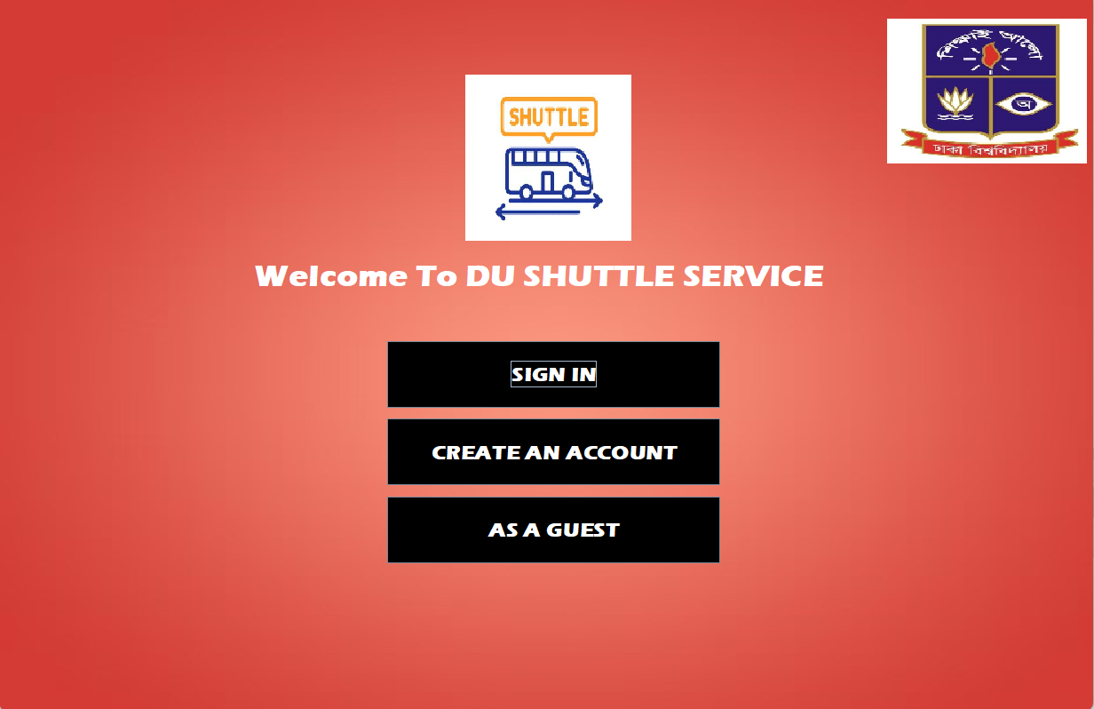
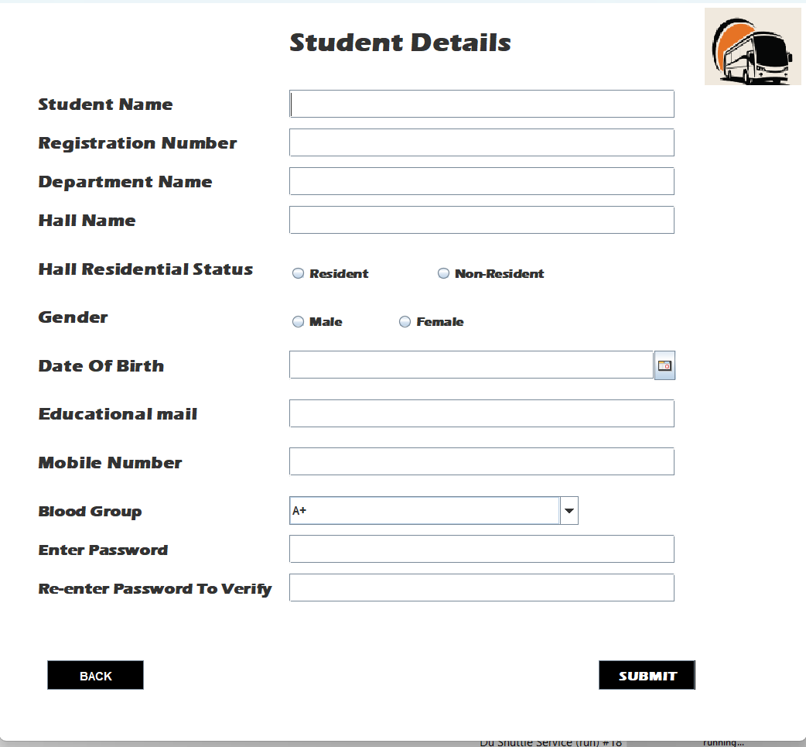
Project Visuals
Start Page
Sign Up

Slide 8
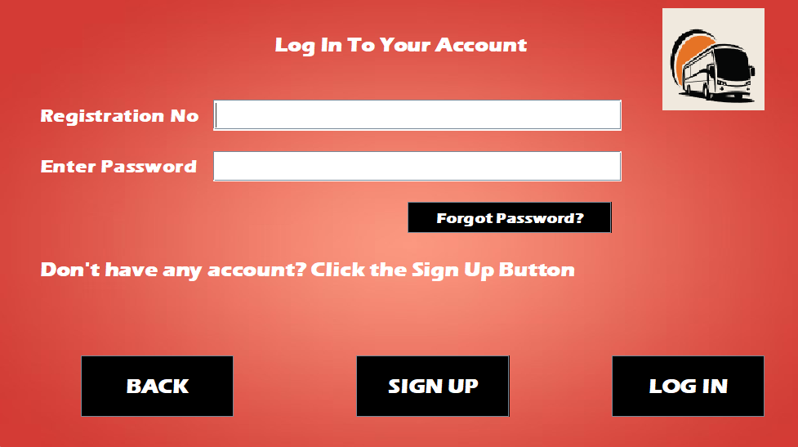
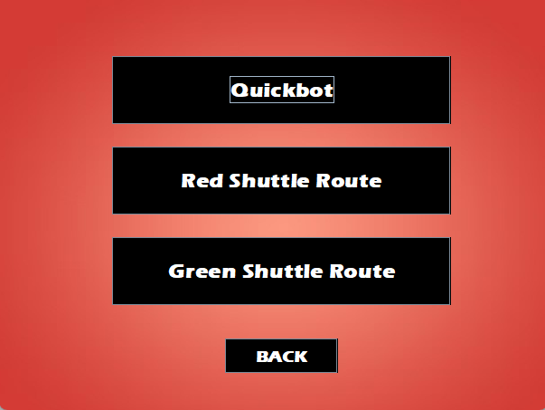
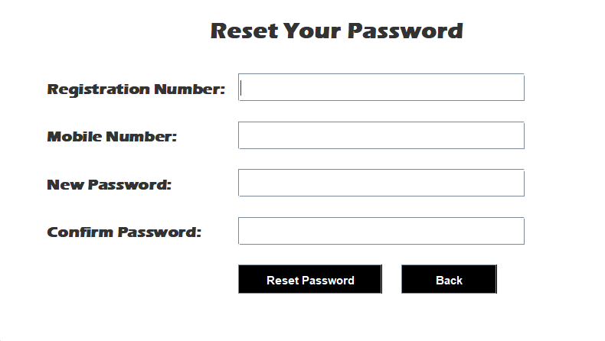
Project Visuals
Sign In
Guest Page

Slide 9
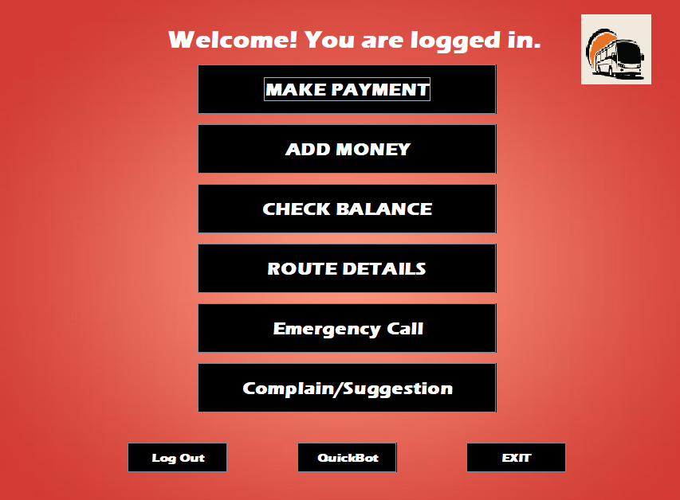
Project Visuals
Profile
(After Login)

Slide 10
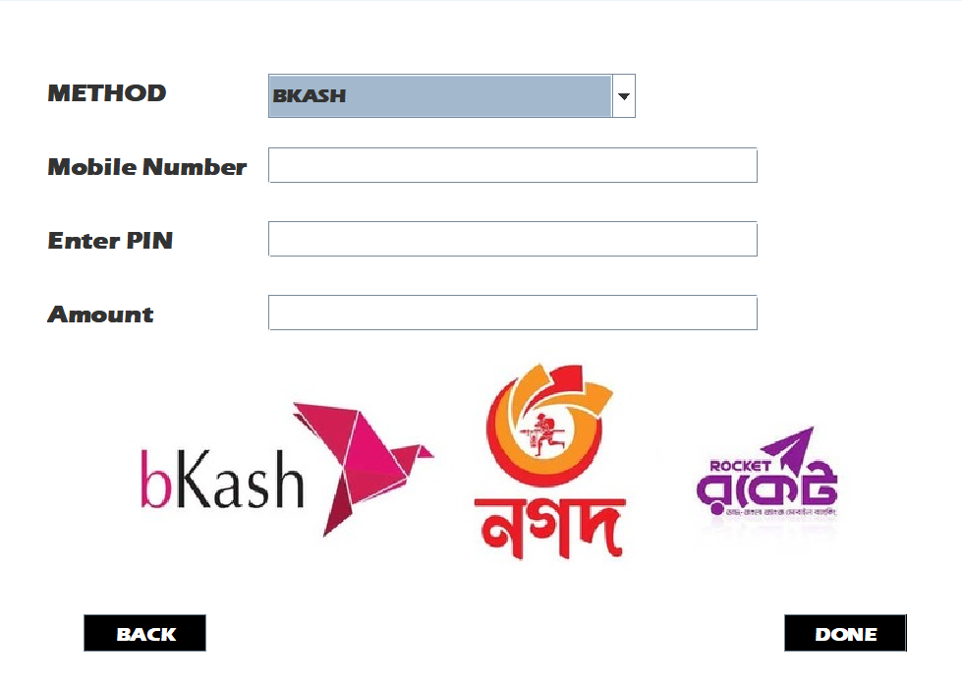
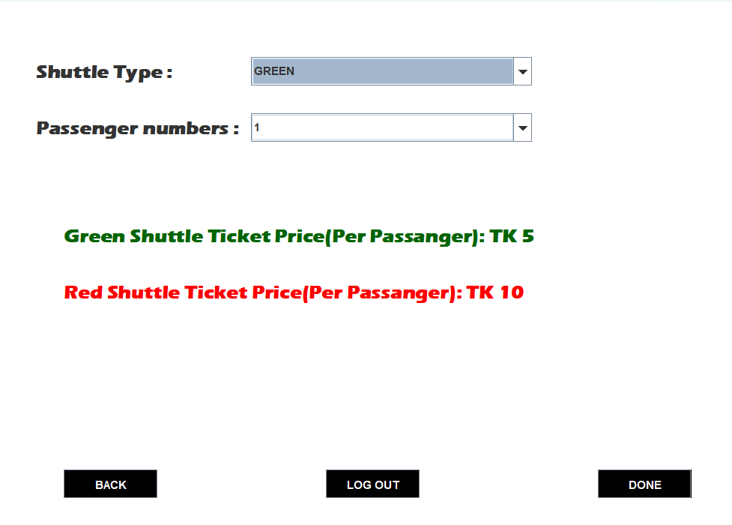
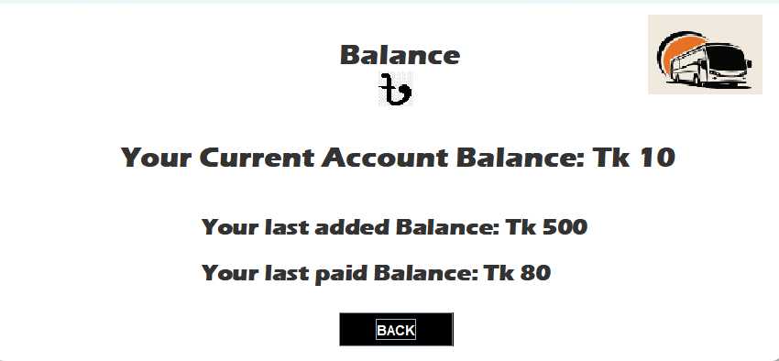
Project Visuals
Add Money
Payment
Balance

Slide 11
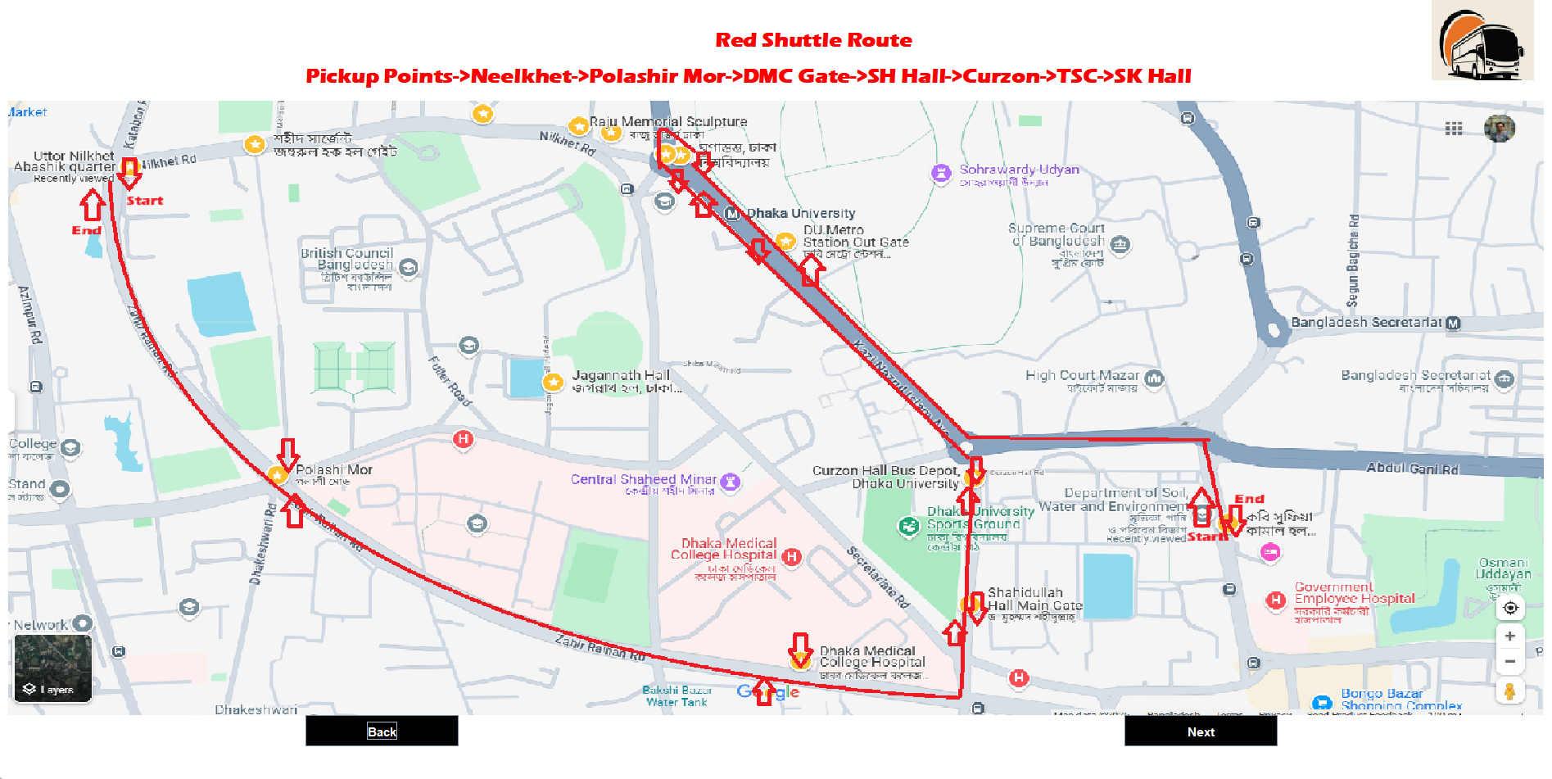
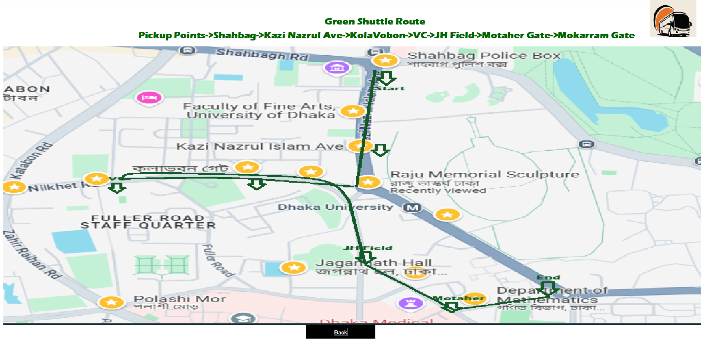
Project Visuals
Red Shuttle Route
Green Shuttle Route

Slide 12
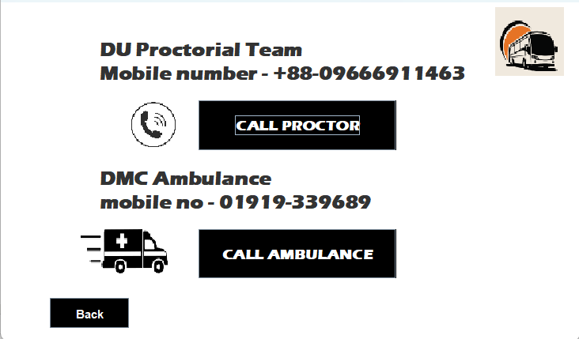
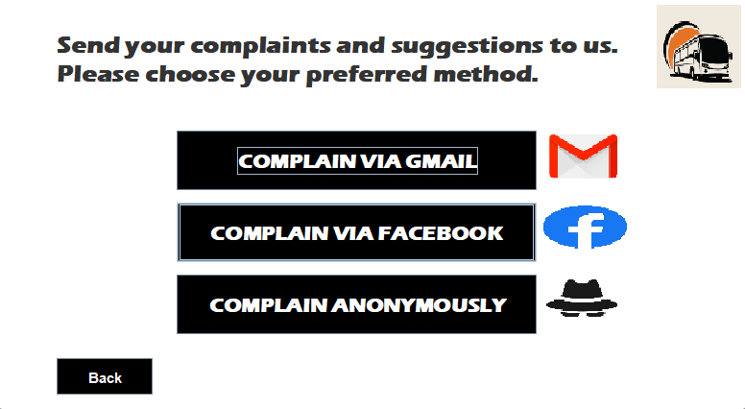
Project Visuals
Emergency
Complain/Suggestion

Slide 13
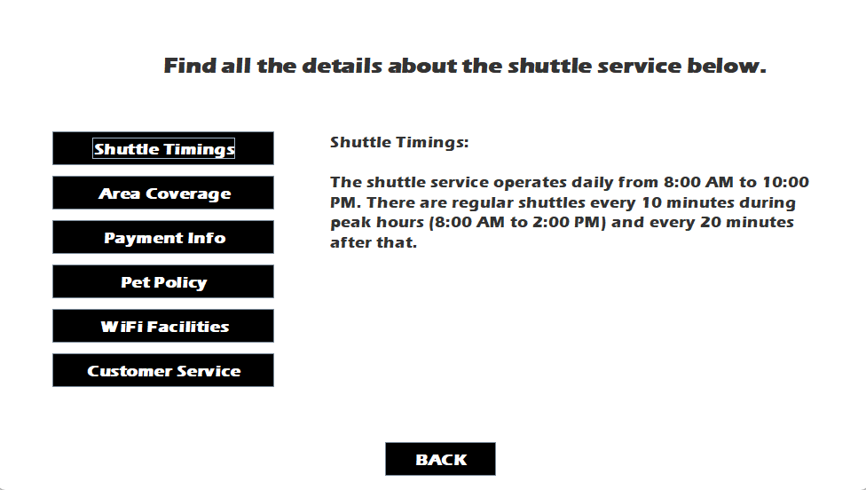
Project Visuals
A quick bot system where you can see the important details by clicking on the queries
QuickBot Service

Slide 14
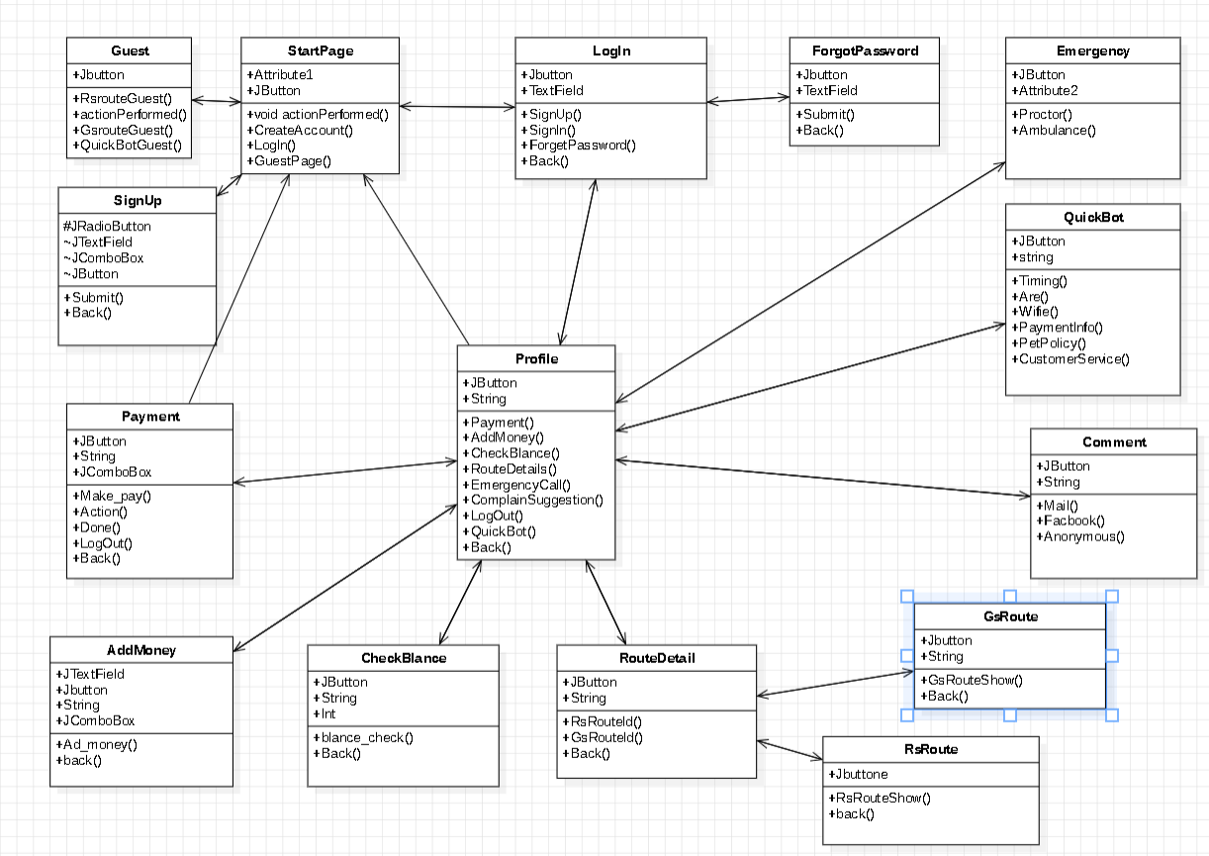
UMl Diagram

Slide 15
Future Implementation
User Interface for admin
Admin can see and control the ticket buying of users
Real-time Shuttle Tracking
Live location of the transports

Slide 16
Conclusion
The DU Shuttle Service project successfully integrates OOP principles, Java Swing and MySQL to create an efficient and user-friendly campus transportation system. It enhances ticketing, payments and route management, making campus travel more seamless and convenient. This project strengthened our technical skills and problem-solving abilities, preparing us for real-world software development challenges.

Slide 17
If you have any questions contact us at-
Email-aditto2022815884@cs.du.ac.bd

Slide 18
Thank You!

